Slide 1
CAPSTONE PROJECT
IBM COURSERA CAPSTONE PROJECT – BEST NEIGHBOURHOOD IN MANHATTAN
By Anmol Dilipkumar Chorgasti

Slide 2
INTRODUCTION
Opening a restaurant requires a lot of factors to be considered. The weather of the location, crime data, cost of infrastructure, tastes of the people, and competition, just to name a few
Manhattan has been chosen amongst the other boroughs of NYC due to its high population density and commercial lifestyle
The people who can benefit from this project are
- Those who are planning to migrate to Manhattan
- A New Yorker trying to change neighbourhoods to find a more happening area
- Those who would like to expand or open their businesses in Manhattan, NYC
- Individuals who already own a restaurant or are looking to open a new one in Manhattan.

Slide 3
DATA ACQUISITION
This project aims to compare the neighbourhoods of Manhattan based on the following data:
- Crime rate data of Manhattan
- Venue data of Manhattan
- Rent data of the selected neighbourhoods of Manhattan
- Weather data of New York City (NYC)
The annual weather data from 2010-2019 for NYC was collected from the website Current results
Data acquisition for Manhattan's neighbourhoods was done through the NYCloc csv file, which was obtained from the week 3 lab in the IBM 'Applied Data Science Capstone project' course
The Venue details have been collected with the help of Foursquare API
The commercial rent data has been collected from Property Shark
The crime data has been collected from the official New York Police Department website

Slide 4
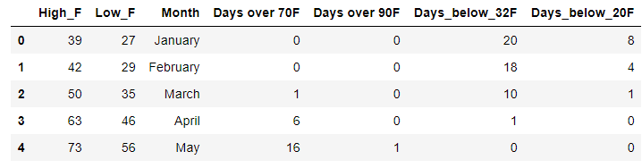
WEATHER DATA ANALYSIS
Using the data shown in the above image, the temperature fluctuations throughout the year were visualized with the help of a line graph. This line graph was a plot showing the highest and lowest temperatures recorded per month. (See graphs in results section)
Another important key point was to get the monthly comparison of the total number of hot and cold days. In order to visualize this, two bar graphs were plotted, one for the number of hot days and one for the number of cold days.
All of the above plotting was carried out through the Matplotlib package in Python.

Slide 5
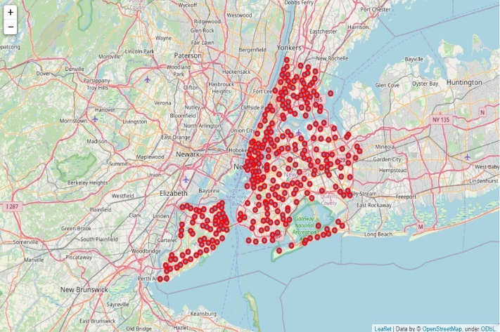
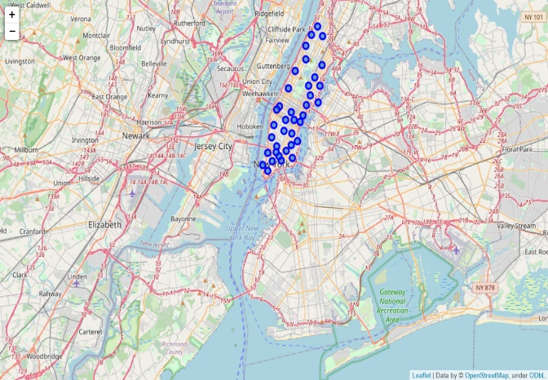
LOCATION DATA ANALYSIS
New York City Map
Manhattan Map
In order to understand how big a part of New York Manhattan is, two maps were plotted using the Folium package. The first map was a map of all the neighbourhoods of New York City and the second one was a map of all the neighbourhoods of Manhattan.
As evidenced by the above two maps, we can see how much of New York City comprises of Manhattan and its neighbourhoods.

Slide 6
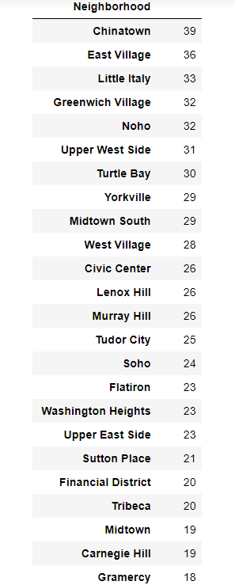
NEIGHBOURHOOD SELECTION
The image shows all the neighbourhoods ranked on the basis of the number of restaurants they have. This data is very important to this project as it is the driving force behind the selection of the neighbourhoods that further analysis will be carried on
The eight neighbourhoods selected are Tudor City, Soho, Flatiron, Washington Heights, Upper East Side, Sutton Place, Financial District, Tribeca
These neighbourhoods were selected because they lie in the 20 to 25 restaurants per neighbourhood range. This range was selected based on the inference that these neighbourhoods have high potential for growth while having a decent restaurant ecosystem and network in place already.

Slide 7
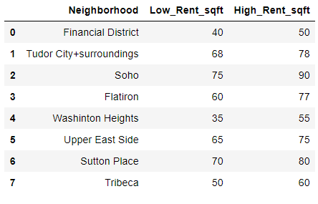
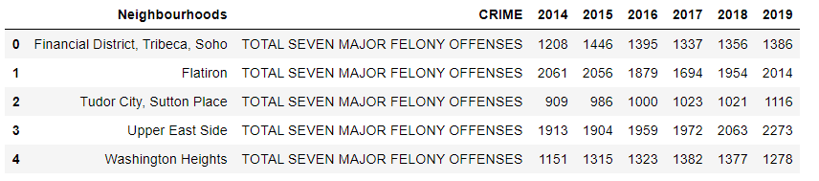
RENT AND CRIME DATA ANALYSIS
Rent Data
Crime Data
After the selection of the eight neighbourhoods, the rent and crime data for these neighbourhoods were collected. Then using the data shown in tables 3 and 4, bar graphs were plotted (see results section) that showed very clearly, the comparison of the prices as well as the crime rate in these neighbourhoods

Slide 8
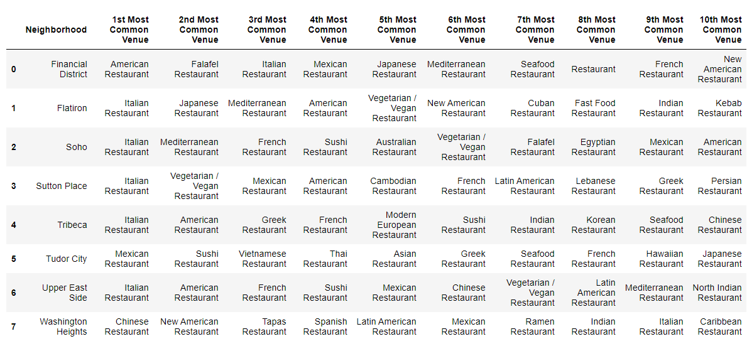
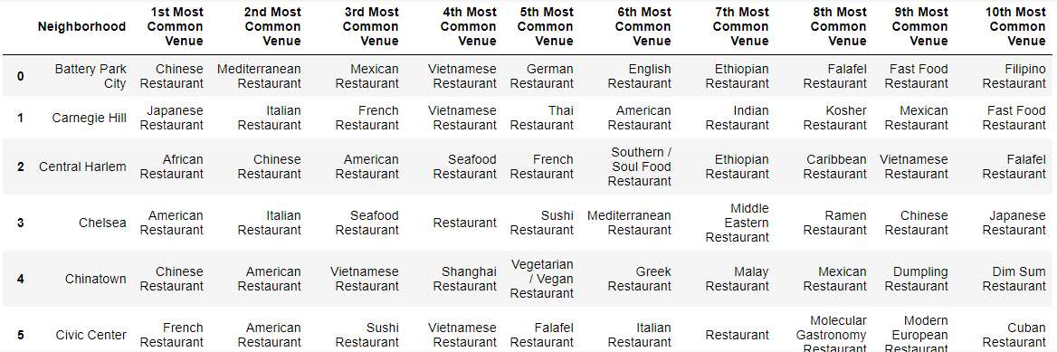
K MEANS CLUSTERING
The two tables shown in this slide were used for creating the two clusters mentioned below. How the clusters look and the inferences that can be made from them will be discussed in the next section
Two clusters were formed during this analysis. One cluster that clustered the 8 neighbourhoods based on their most popular cuisines. The second cluster was a cluster of all the neighbourhoods in Manhattan based on the popularity of their cuisines It gave us a clear visual of whether there were any predominant clusters that the 8 neighbourhoods were a part of.

Slide 9
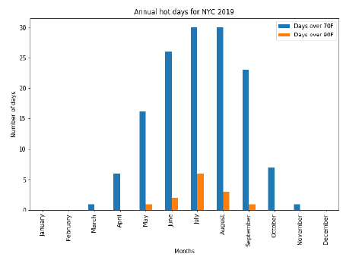
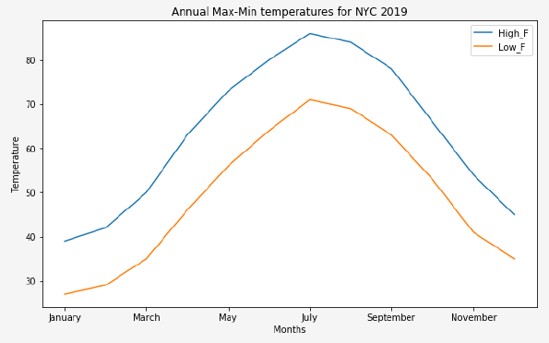
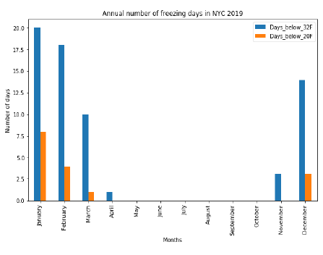
RESULTS AND CONCLUSION
Weather Data Analysis
NYC experiences its hottest days between May to September, and its coldest days from November to March.
Hottest days
(May – Sep)
Coldest days
(Nov – Mar)
Annual temperatures of NYC 2019

Slide 10
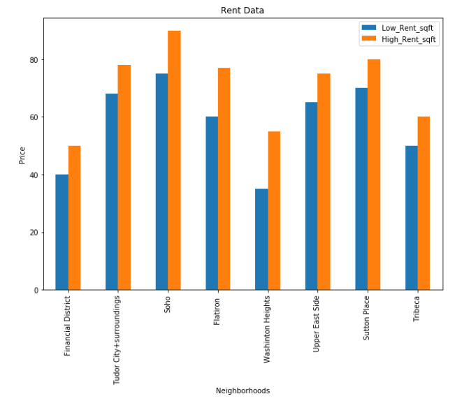
Results and Conclusion (continued)
Rent Data Analysis
Financial District, Washington Heights, and Tribeca have some of the best and cheapest commercial rent rates.
Rent price for Manhattan neighborhoods

Slide 11
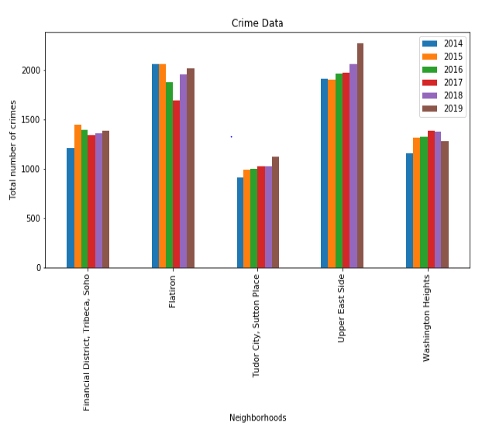
Results and Conclusion (continued)
Crime Data Analysis
Tudor City, Sutton Place, Washington Heights, and Financial District have low crime rates. Washington Heights has also experienced a drop in the total crimes committed in 2019.
Crimes committed (2014-2019) in Manhattan neighborhoods
(grouped by precinct)

Slide 12
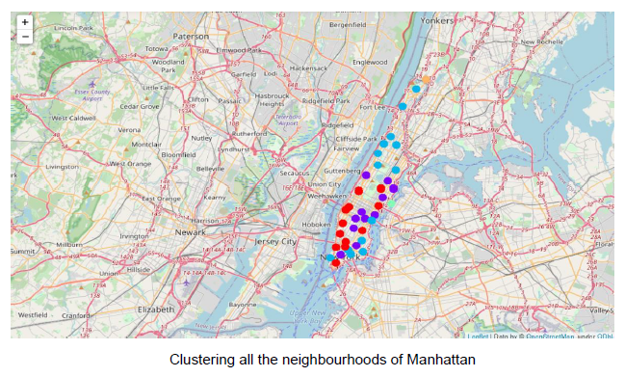
Results and Conclusion (continued)
Clustering Analysis
Cluster 1: Flatiron, Soho, Sutton Place, Upper East Side – Purple
Cluster 2: Washington Heights, Tudor City – Blue
Cluster 3: – Green
Cluster 4: Tribeca – Orange
Cluster 0: Financial District – Red

Slide 13
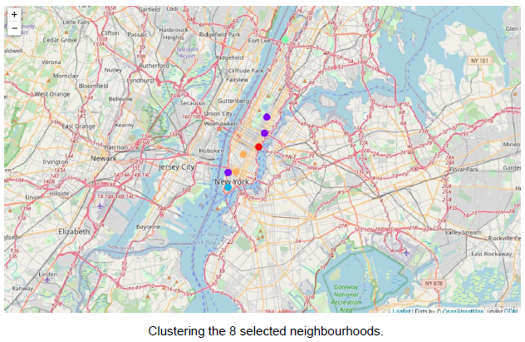
Results and Conclusion (continued)
Clustering Analysis
Cluster 1: Flatiron, Soho, Sutton Place, Upper East Side – Purple
Cluster 2: Tudor City – Red
Cluster 3: Financial District – Blue
Cluster 4: Tribeca – Orange
Cluster 0: Washington Heights – Green
The dominant clusters are Cluster 0 (Blue), Cluster 1 (Purple), Cluster 2 (Red). It can be inferred that the residents staying in the neighbourhoods belonging to any of these three clusters share more or less similar restaurant tastes i.e. residents of neighbourhoods belonging to the same cluster may share similar preferences.

Slide 14
Results and Conclusion (continued)
Choosing a cuisine prevalent in dominant clusters is a good way to attract customers to a new restaurant due to popular demand
Based on rent (low) and crime (low) data analysis, the best choices of neighbourhoods to open a restaurant in Manhattan are
Washington Heights (Cluster 2)
Financial District (Cluster 0)
Based on taste profiles of residents
a Chinese, Spanish, Italian, Mexican restaurant may find success in Washington Heights
a Japanese, Mediterranean, French, Seafood, Falafel restaurant may find success in Financial District.

